Slide 2
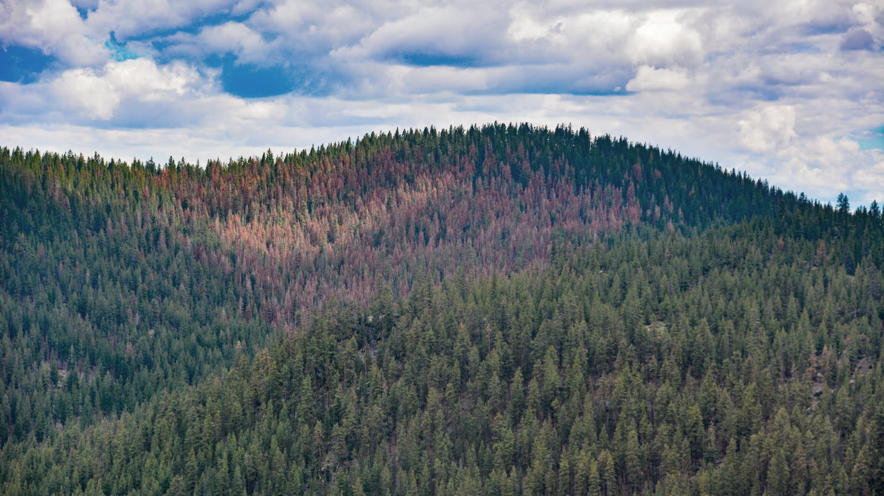
How are subalpine forest systems responding to this confluence of global change drivers?
Subalpine fir as an initial leverage point and case study
Range-wide status, population trends, and mortality sources
PC: Daniel DePinte, USFS FHM

Slide 3

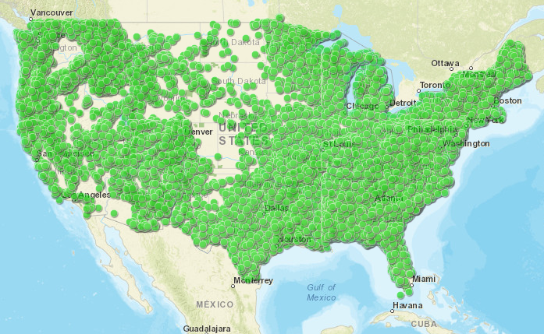
US Forest Service Forest Inventory & Analysis (FIA) Program
USDA Forest Service 2024

Slide 4
US Forest Service Forest Inventory & Analysis (FIA) Program
~355,000 permanent inventory plots
>19 million tracked individual trees
10-year remeasurement cycle (western US)
USDA Forest Service 2024

Slide 5
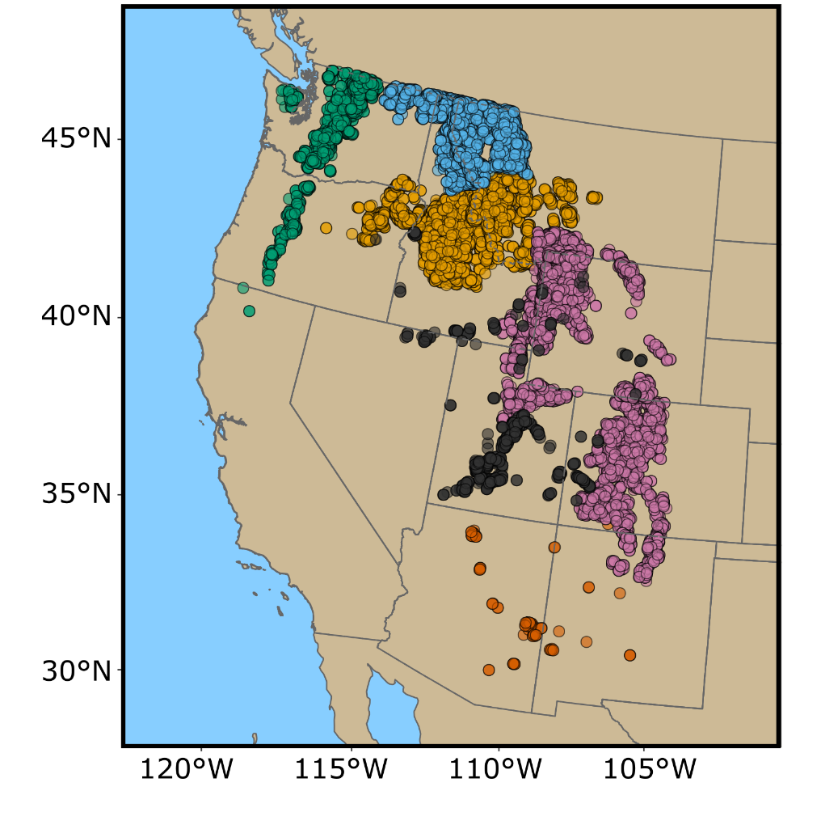
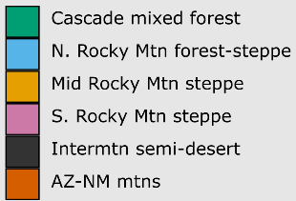
FIA for subalpine fir
~ 6700 plots currently contain
subalpine fir
~ 5100 plot remeasurements
~ 97,000 individual trees

Slide 6
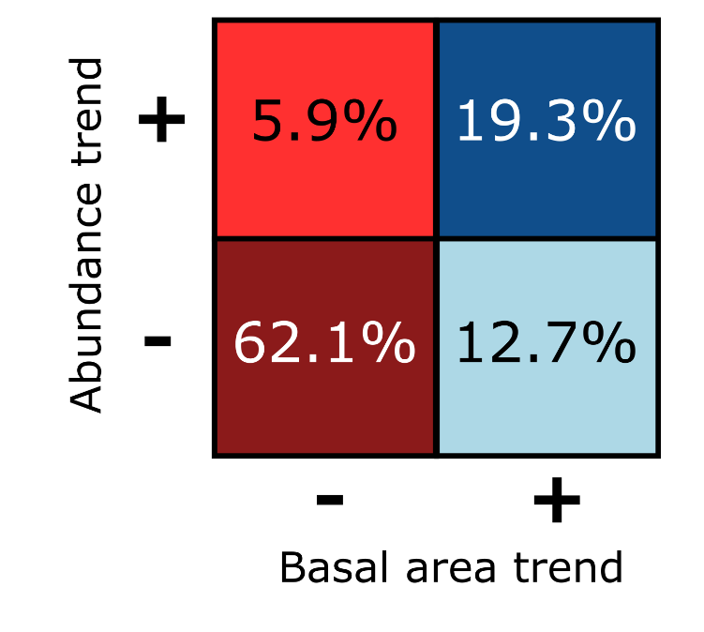
Perret et al., 2023. For. Ecol. & Mgmt.

Slide 7
turnover
Perret et al., 2023. For. Ecol. & Mgmt.

Slide 8
turnover
development
Perret et al., 2023. For. Ecol. & Mgmt.

Slide 9
turnover
densification
decline
development
Perret et al., 2023. For. Ecol. & Mgmt.

Slide 10
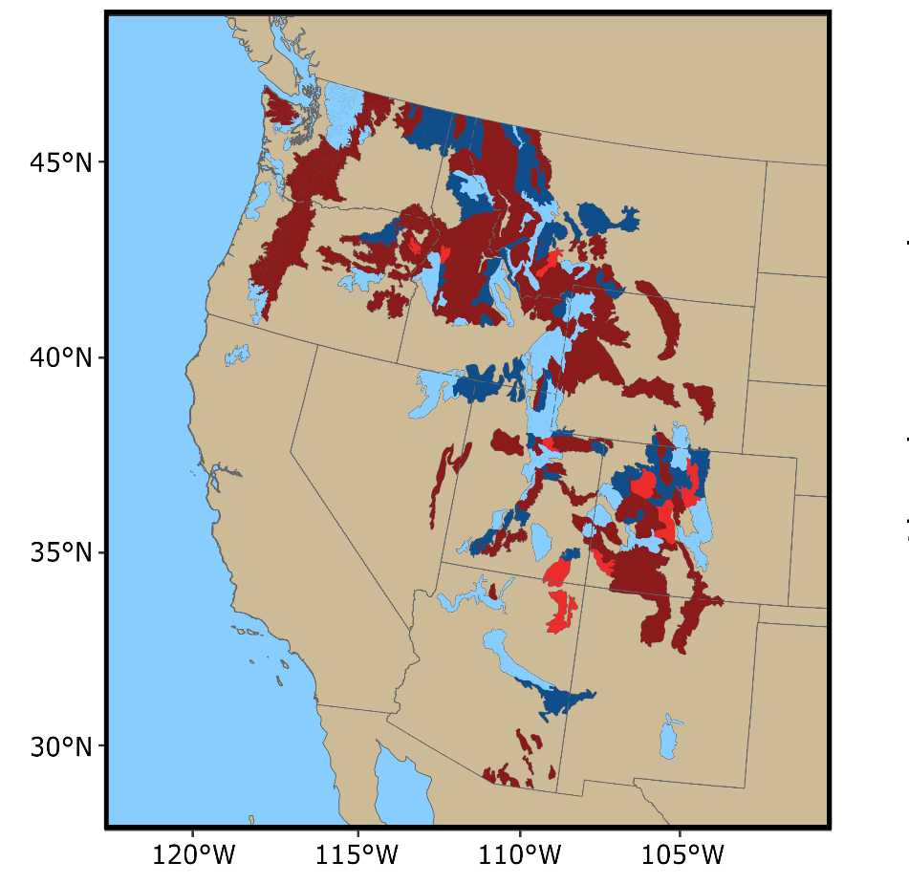
2000-2009 to 2010-2019 inventory period
General decline across 62% of subalpine fir range
Perret et al., 2023. For. Ecol. & Mgmt.
Notes:
Imp’t point that these show change between (2000-2010) period and (2010-2019) period…. Combining panels to reduce uncertainty, but losing temporal resolution. If we look only at data from the most recent panel, we see kind of the same thing… will do that in the modeling bit by adding a YEAR covariate

Slide 11

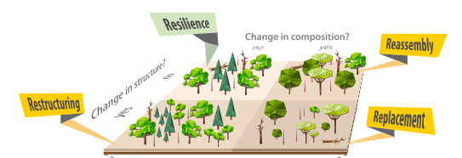

Slide 12
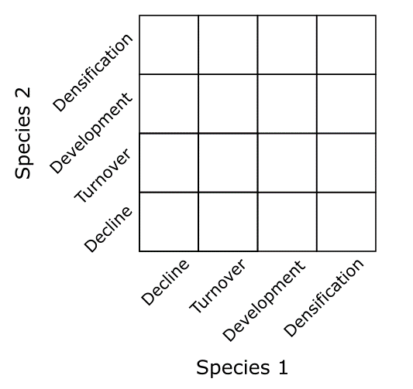
Single species trajectory
Joint species trajectory

Slide 13
Joint species trajectory
Seidl & Turner 2022

Slide 14
Joint species trajectory
Seidl & Turner 2022
resilience

Slide 15
Joint species trajectory
Seidl & Turner 2022
resilience
restructuring

Slide 16
Joint species trajectory
Seidl & Turner 2022
resilience
restructuring
reassembly

Slide 17
Joint species trajectory
Seidl & Turner 2022
resilience
restructuring
reassembly
replacement

Slide 18
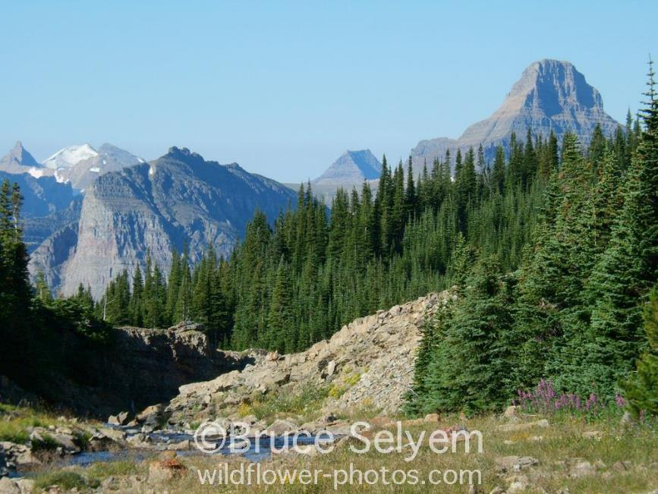
Joint species trajectory
Subalpine fir – Engelmann spruce

Slide 19
Subalpine fir
fast demography
high regeneration
fast growth
low survival
Engelmann spruce
slow demography
low regeneration
slow growth
high survival
Subalpine fir – Engelmann spruce
Andrus et al. 2018. Can. J. For. Res.
Shea 1985. Am. J. Bot.

Slide 20
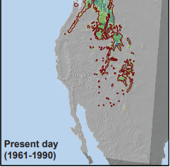
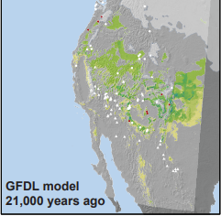
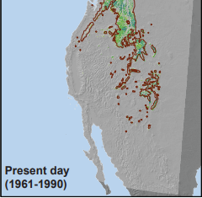
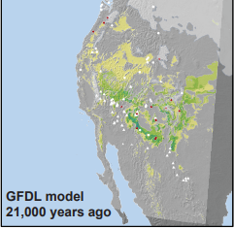
Subalpine fir
fast demography
high regeneration
fast growth
low survival
Engelmann spruce
slow demography
low regeneration
slow growth
high survival
Andrus et al. 2018. Can. J. For. Res.
Shea 1985. Am. J. Bot.
Roberts & Hamann 2018. Proc. R. Soc. B

Slide 21



Could currently-changing climate and disturbance drive a similar “disassembly”?
Roberts & Hamann 2018. Proc. R. Soc. B

Slide 22
Connect reorganization trajectories to demographic coexistence mechanisms
Could currently-changing climate and disturbance drive a similar “disassembly”?

Slide 23
Connect reorganization trajectories to demographic coexistence mechanisms
Could currently-changing climate and disturbance drive a similar “disassembly”?
Future climate and disturbance scenarios

Slide 24
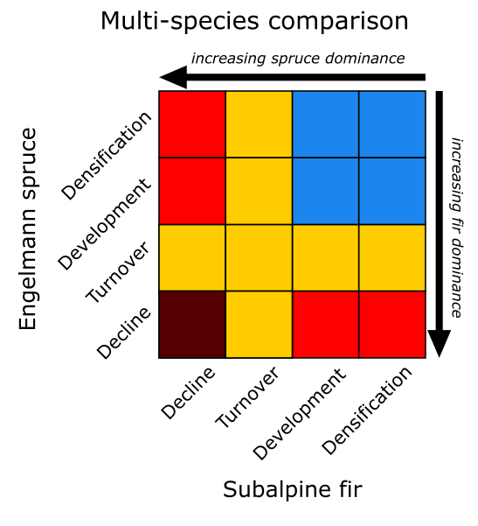
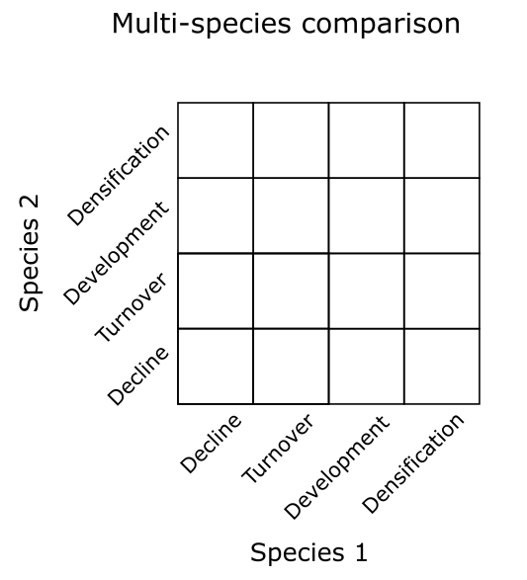
resilience
restructuring
reassembly
replacement

Slide 25
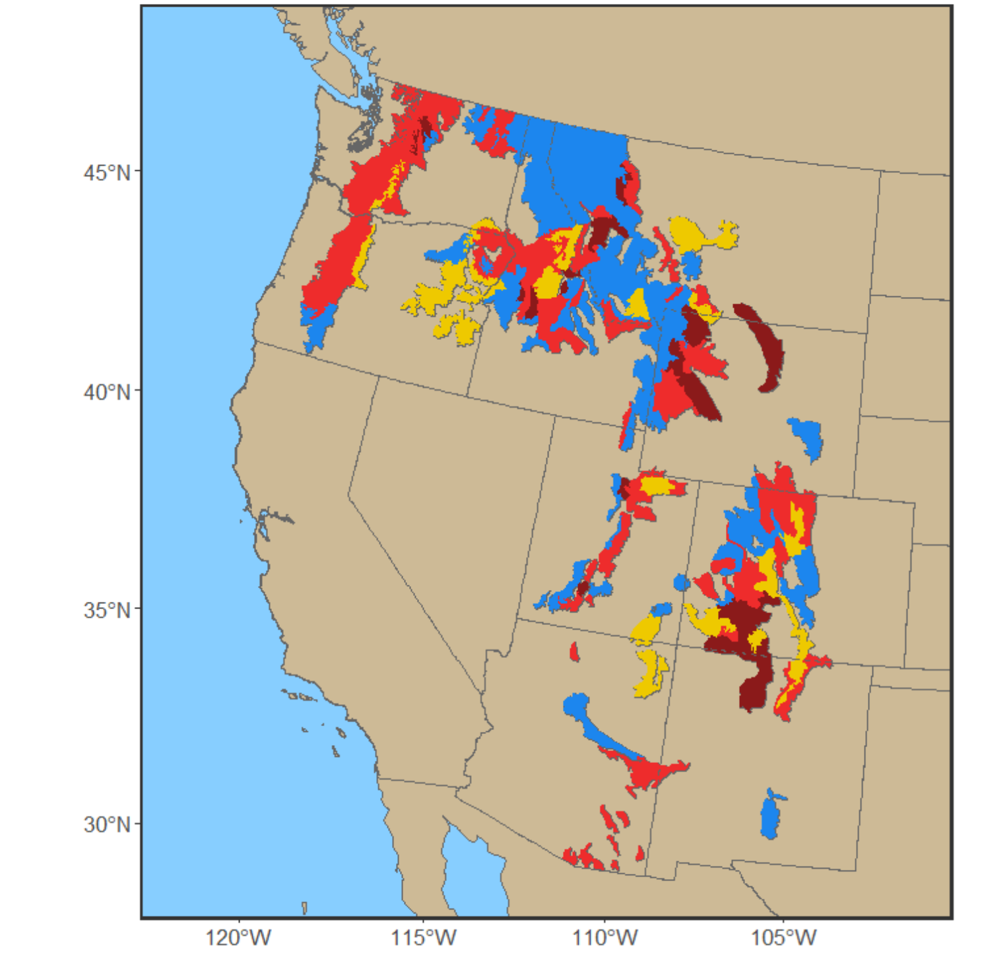
23.4%
38.3%
13.0%
10.1%
15.2%
resilience
restructuring
reassembly
replacement
Perret, Bell, & Zald in prep.

Slide 26
Mortality
~
Climate anomalies
x
Fire extent and severity
Regeneration
Recruitment

Slide 27

Mortality
~
Climate anomalies
x
Fire extent and severity
Regeneration
Recruitment
Mortality
~
Regeneration
Recruitment

Slide 28
Perret, Bell, & Zald in prep.
resilience
restructuring
reassembly
replacement

Slide 29
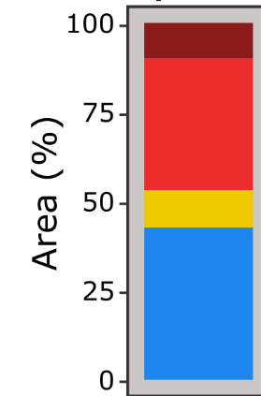
Perret, Bell, & Zald in prep.
2009 – 2019
observed
resilience
restructuring
reassembly
replacement

Slide 30
Perret, Bell, & Zald in prep.
2009 – 2019
observed
2040-2050
SSP3-7.0
2070-2080
SSP3-7.0
resilience
restructuring
reassembly
replacement

Slide 31
Perret, Bell, & Zald in prep.
High disturbance
20% area burned at 90% mortality
Low disturbance
5% area burned at 50% mortality
2009 – 2019
observed
2040-2050
SSP3-7.0
2070-2080
SSP3-7.0
resilience
restructuring
reassembly
replacement

Slide 32
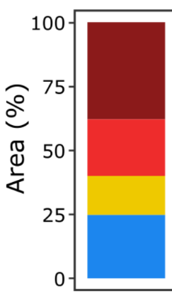
Perret, Bell, & Zald in prep.
High disturbance
20% area burned at 90% mortality
Low disturbance
5% area burned at 50% mortality
2009 – 2019
observed
2040-2050
SSP3-7.0
2070-2080
SSP3-7.0
resilience
restructuring
reassembly
replacement

Slide 33
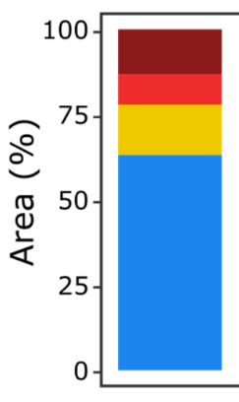
Perret, Bell, & Zald in prep.
High disturbance
20% area burned at 90% mortality
Low disturbance
5% area burned at 50% mortality
2009 – 2019
observed
2040-2050
SSP3-7.0
2070-2080
SSP3-7.0
resilience
restructuring
reassembly
replacement

Slide 34
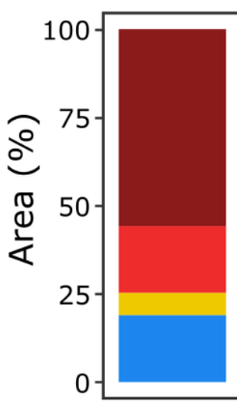
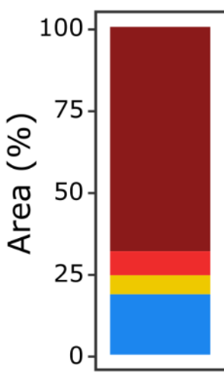
Perret, Bell, & Zald in prep.
High disturbance
20% area burned at 90% mortality
Low disturbance
5% area burned at 50% mortality
2009 – 2019
observed
2040-2050
SSP3-7.0
2070-2080
SSP3-7.0
resilience
restructuring
reassembly
replacement

Slide 35
Perret, Bell, & Zald in prep.
closing window of opportunity to manage for
greater resilience
in spruce-fir forests
2040-2050
SSP3-7.0
2070-2080
SSP3-7.0
resilience
restructuring
reassembly
replacement

Slide 36
2040-2050
SSP3-7.0
resilience
restructuring
reassembly
replacement

Slide 37
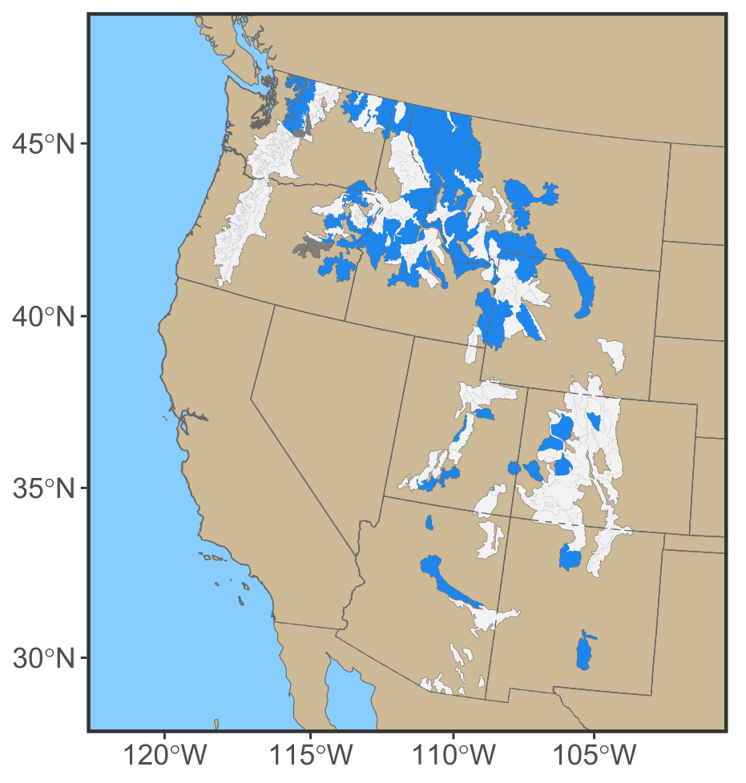
2040-2050
SSP3-7.0
Perret, Bell, & Zald in prep.
opportunity
nope

Slide 38
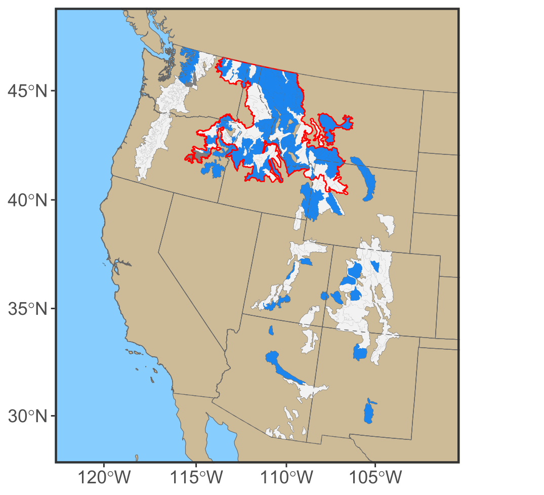
Northern Rockies contain 76% of opportunity hotspots range-wide
Perret, Bell, & Zald in prep.
opportunity
nope

Slide 39

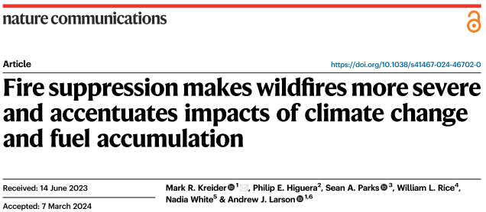
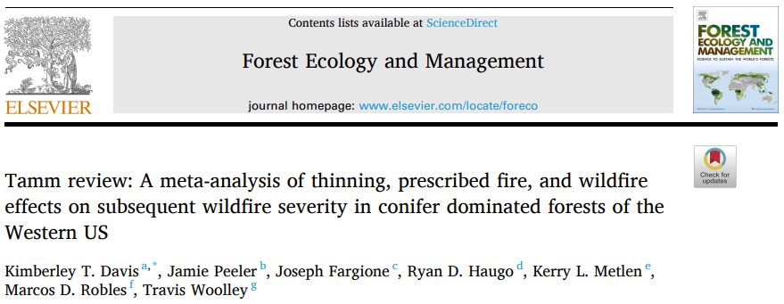
Davis et al. 2023
Northern Rockies contain 76% of opportunity hotspots range-wide
Perret, Bell, & Zald in prep.
opportunity
nope

Slide 40
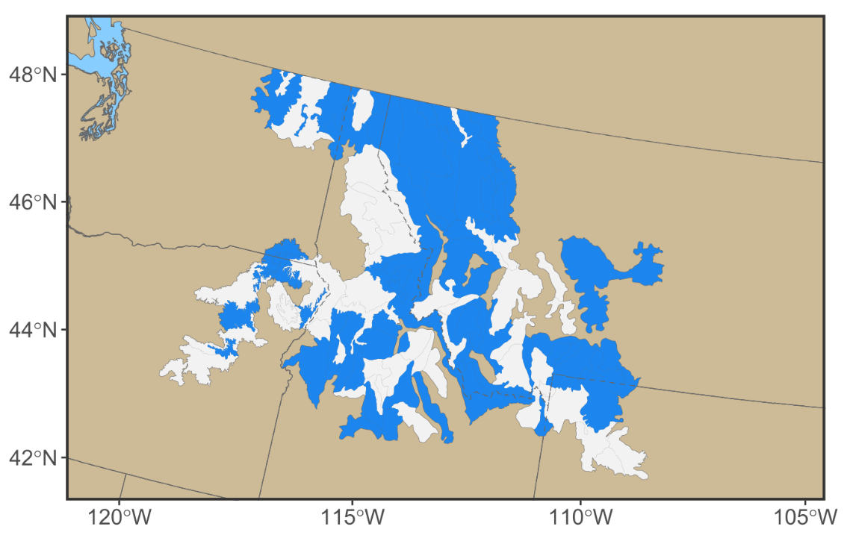
Northern Rockies contain 76% of opportunity hotspots range-wide
Perret, Bell, & Zald in prep.
opportunity
nope

